Slide 1
Clinical Block 1

Slide 2
Test to Real World Characteristics
Let’s say we have a test for a specific disease, and we want to know:
The prevalence of the disease
The characteristics of the test

Slide 3
The Truth
 | Disease | Non Disease | Total
Positive | True Positive | False Positive | Test Positive
Negative | False Negative | True Negative | Test Negative
 | Total Disease | Total Non Disease | Total
Test Result

Slide 4
The Truth
A good test has most of the numbers in the blue area and not the red area.
 | Disease | Non Disease | Total
Positive | True Positive | False Positive | Test Positive
Negative | False Negative | True Negative | Test Negative
 | Total Disease | Total Non Disease | Total
Test Result

Slide 5
The Truth
Prevalence is the total in the disease column / divided by the total people X 100
 | Disease | Non Disease | Total
Positive | True Positive | False Positive | Test Positive
Negative | False Negative | True Negative | Test Negative
 | Total Disease | Total Non Disease | Total
Test Result
The population/sample used heavily influences prevalence numbers.

Slide 6
The Truth
Sensitivity is the probability that a test will indicate disease among those with the disease
True Positive / Total Disease X 100
 | Disease | Non Disease | Total
Positive | True Positive | False Positive | Test Positive
Negative | False Negative | True Negative | Test Negative
 | Total Disease | Total Non Disease | Total
Test Result

Slide 7
The Truth
Specificity percent of those without disease who will have a negative test result.
True Negative / Total Non Disease X 100
 | Disease | Non Disease | Total
Positive | True Positive | False Positive | Test Positive
Negative | False Negative | True Negative | Test Negative
 | Total Disease | Total Non Disease | Total
Test Result
Sensitivity and specificity are characteristics of the test

Slide 8
The Truth
What is the chance that a person with a positive test truly has the disease?
Positive predictive value is True Positive / Test Positive X 100
 | Disease | Non Disease | Total
Positive | True Positive | False Positive | Test Positive
Negative | False Negative | True Negative | Test Negative
 | Total Disease | Total Non Disease | Total
Test Result

Slide 9
The Truth
What is the chance that a person with a negative test truly does no have the disease?
Negative predictive value is True Negative/ Test Negative X 100
 | Disease | Non Disease | Total
Positive | True Positive | False Positive | Test Positive
Negative | False Negative | True Negative | Test Negative
 | Total Disease | Total Non Disease | Total
Test Result
Positive and negative predictive values are influenced by the prevalence of disease in the population that is being tested.

Slide 10
The Truth
Example 1
Prevalence 15/100
Sensitivity 10/15
Specificity 45/85
PPV 10/50
NPV 45/50
 | Disease | Non Disease | Total
Positive | True Positive 10 | False Positive 40 | Test Positive 50
Negative | False Negative 5 | True Negative 45 | Test Negative 50
 | Total Disease 15 | Total Non Disease 85 | Total 100
Test Result

Slide 11
The Truth
Example 2
Prevalence 30/100
Sensitivity 20/30
Specificity 37/70
PPV 20/53
NPV 37/47
 | Disease | Non Disease | Total
Positive | True Positive 20 | False Positive 33 | Test Positive 53
Negative | False Negative 10 | True Negative 37 | Test Negative 47
 | Total Disease 30 | Total Non Disease 70 | Total 100
Test Result
Higher prevalence increases PPV (when specificity and sensitivity are held constant).

Slide 12
Likelihood Ratios
Likelihood that a given test result would be expected in a patient with the target disorder compared to the likelihood that that same result would be expected in a patient without the target disorder
LR+ Sensitivity / (1-Specificity)
LR- (1-Sensitivity) / Specificity
You can also weigh these values by prevalence.

Slide 13
Calculate these values!
http://vassarstats.net/clin1.html
Watch the order of the calculator…

Slide 14
Receiver Operator Characteristic (ROC) Curves
An extension of sensitivity and specificity for tests without simple binary categories.
True positive rate (Sensitivity) is plotted in function of the false positive rate (100-Specificity) for different cut-off criterion.

Slide 15
Receiver Operator Characteristic (ROC) Curves
Each point on the ROC curve represents a sensitivity/specificity pair corresponding to a particular decision threshold.
The area under the ROC curve is a measure of how well a parameter can distinguish between two diagnostic groups (diseased/normal).

Slide 16
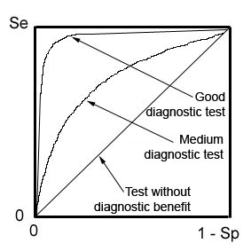
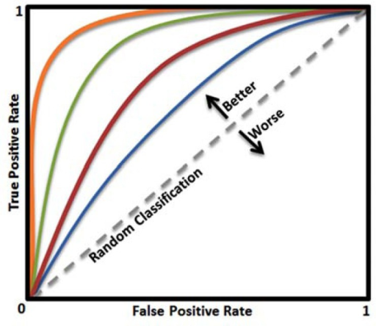
Receiver Operator Characteristic (ROC) Curves

Slide 17
Receiver Operator Characteristic (ROC) Curves
http://vassarstats.net/roc1.html
The picture isn’t working ☹
But we can paste those results into Excel! (see attached sheet)

